Slide 1


News popularity in Multiple social media platforms
Hemanth Reddy Musipatla

Slide 2


DATA CLEANING
From the cleaned dataset-1, column ‘Source’ contains lot of new outlets. By further processing they are grouped in to four categories A,B,C and D based on their number of occurrences.
In Column “Publish date”, both time and date are separated, and Time is converted into two additional columns by passing it through sin function and cos function.

Slide 3


TEXT PROCESSING
For Text processing we use Natural Language Processing
we use stopwords from nltk package to split the sentences into stop words. Then these words have to be converted to features which can be done using the “TfidfVectorizer” function from sklearn.
Text is converted into features, and Merged to main_df.
Finally, using One-hot encoding method, categorical values are converted to numerical data.
->Function used : (get_dummies function)

Slide 4
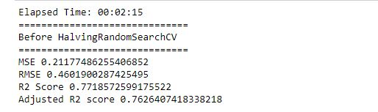

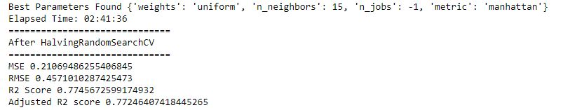

MODEL STRUCTURE SELECTION
K – NEAREST NEIGHBOR
LINEAR REGRESSION
We used Halving Random Search for tuning the hyperparameters.
Results before tuning the model. Accuracy: 77.19%
Results after tuning the model. Accuracy 77.45%
We used Grid Search for tuning the hyperparameters.
Results before tuning the model. Accuracy: 32.49%
Results after tuning the model. Accuracy: 35.11%

Slide 5
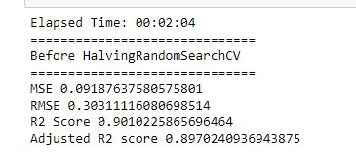
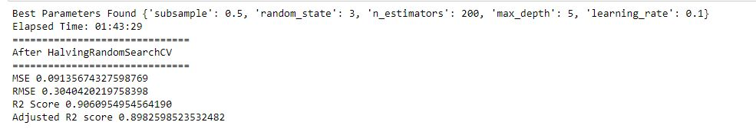
GRADIENT BOOSTING
Gradient Boosting produces a predictive model from an ensemble of weak predictive models.
In order to identify the best hyperparameter values, halving randomsearch chooses and tests several combinations of hyperparameters at random.
Results before tuning the hyperparameters. Accuracy 90.1%
Results after tuning the hyperparameters. Accuracy 90.6%

Slide 6


RANDOM FOREST
Random forest is an ensemble learning method for regression and classification.
Every parameter combination can be fit by a grid search, and the best parameters are chosen based on which model has the highest score.
The results of the model before tuning. Accuracy: 92.73%.
The results of the model after tuning. Accuracy: 92.54%

Slide 7
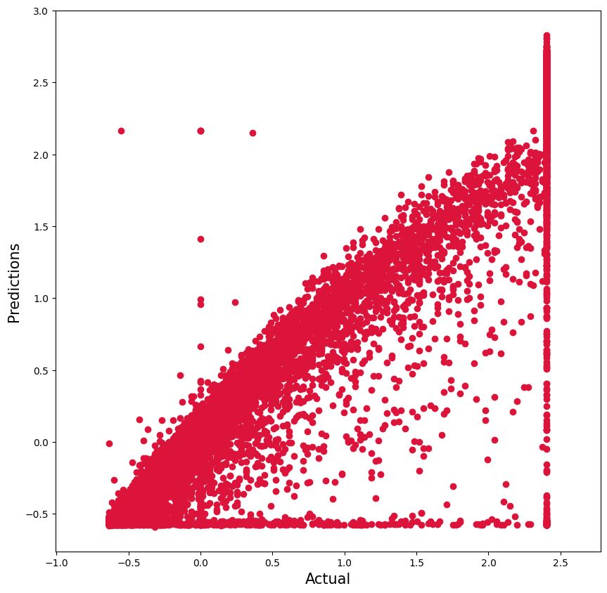
A comparison with SVM (Baseline)
A baseline is a technique that makes predictions for a dataset using basic statistics, randomness, or ML. The performance of the baseline can be evaluated using these predictions (for example, R2 score)
Generally speaking, you want your strategy to perform better than the chosen baselines
So, here we have use SVM as baseline comparing to other models.
MSE -0.118
RMSE -0.344
R2 SCORE -0.8718
Adjusted R2 SCORE -0.8667

Slide 8
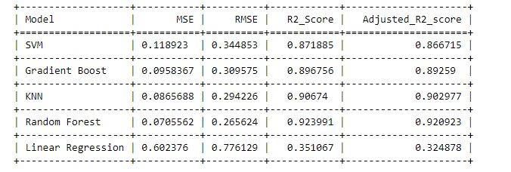

COMPARISION OF TEST RESULTS
Here we are comparing the R2 scores from the below table. Compared to all the models, Random Forest regressor with grid search cv has performed good compared to other models.

